Slide 1

Fiscal Federalism
David Garcia
UEF Secretariat
Federalist Academy, 8-10 July 2016, Brussels

Slide 2
INTRODUCTION

Slide 3

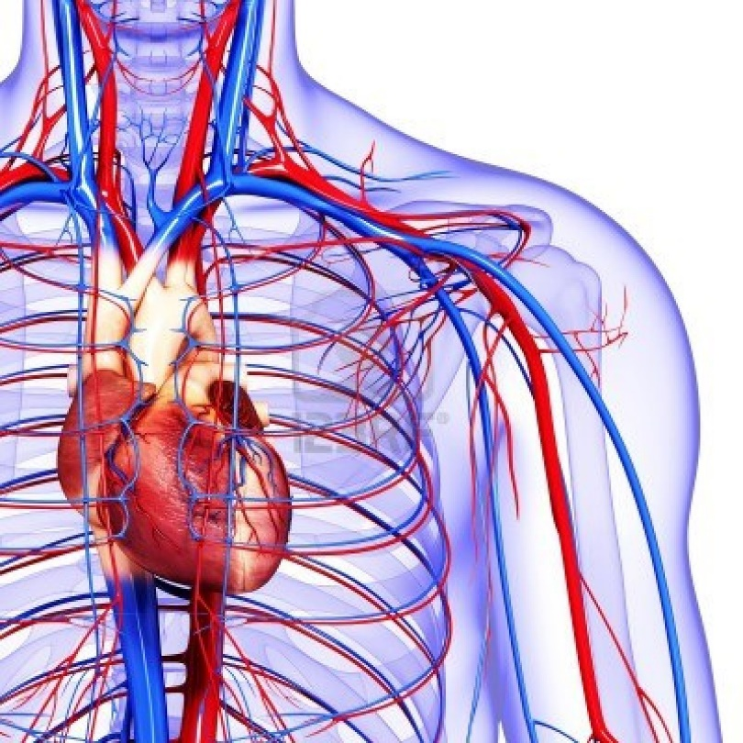
What is the fiscal policy?
1. It is about MONEY:
Revenue
Resources: Taxes, excises, fines, tariff duties, contributions, etc.
Virtually every policy decision has fiscal implications!
Expenditure
Implementation of policies: public salaries, investment, grants, subsidies, etc.

Slide 4
What is fiscal federalism?
“Fiscal federalism constitutes a set of guiding principles, a guiding concept that helps in designing financial relations between different levels of government”
Chanchal Kumar Sharma

Slide 5
Today’s discussion
Objectives of fiscal federalism
Welfare maximisation
Fiscal equalisation
Market preservation
Practical cases

Slide 6
OBJECTIVES OF FEDERAL FISCAL POLICIES
1. Welfare maximisation

Slide 7
Challenges of fiscal policy in federal systems
Welfare maximisation
Fiscal equalisation
Which repartition of resources and expenditure?
Market preservation

Slide 8

1. Welfare maximisation
Lower level
Democratic participation
Higher level
Interdependence of markets
Economies of scale
Better implementation
Local particularities
Fairer general fiscal system

Slide 9
1. Welfare maximisation
Lower level
Democratic participation
Higher level
Interdependence of markets
Economies of scale
Better implementation
Local particularities
Fairer general fiscal system
Scale
Ability to act
Political preferences

Slide 10
1. Welfare maximisation
Lower level
Democratic participation
Higher level
Interdependence of markets
Economies of scale
Better implementation
Local particularities
Fairer general fiscal system
Scale
Ability to act
Political preferences

Slide 11
Local particularities VS Economies of scale

Slide 12
Local particularities VS Economies of scale
Loss for the retired / Excedent for the unemployed

Slide 13
Local particularities VS Economies of scale
Possible economies of scale

Slide 14
Better implementation at lower level VS interdependence of markets
Case 1
Fiscal programme aiming at improving diet of -18 y.o.’s
Revenue: country-wide tax on sodas & snacks
Local particularity (-18 obesity)
Expenditure: subventions to school canteens conditioned to increase in purcharse of healthier and local products
Greater capacity to monitor schools
Better knowledge of local providers

Slide 15

Better implementation at lower level VS interdependence of markets
Case 2
Value-Added Tax (VAT) in an internal market to pay for better roads
€
€
€
+ VAT
€
€
€
no VAT
DISTORSION
😐
😐
☺
☺
😐
☺
😐
☺
😐
😐
☺
☺
😐
☺
😐
😐
☺
☺

Slide 16
Democratic participation VS Fairer fiscal system
$
$
Pensions!
Corporate taxation!
Internalisation of spillovers
☹
☹
☹
☹
Corporate taxation!
Pensions!

Slide 17
OBJECTIVES OF FEDERAL FISCAL POLICIES
2. Fiscal equalisation

Slide 18





2. Fiscal equalisation
Conventional economic tools:
☹
☹
☹
☹
Salaries
Pensions
☹

Slide 19
2. Fiscal equalisation

Slide 20
Do federations need fiscal equalization?
Yes
Loss of conventional economic tools
Ever widening gap
No
Economies will converge towards optimal allocation of resources

Slide 21
A political choice
National preferences will change!
No fiscal equalization
Market dynamic
Fiscal equalization
Possibility to decide on new preferences

Slide 22
OBJECTIVES OF FEDERAL FISCAL POLICIES
3. Market preservation

Slide 23












3. Market preservation – Simple market-led integration

Slide 24
3. Market preservation – With insurance scheme

Slide 25
3. Market preservation – With insurance scheme

Slide 26
3. Market preservation – With insurance scheme

Slide 27
3. Market preservation – With insurance scheme

Slide 28
3. Market preservation – With insurance scheme

Slide 29
3. Market preservation – With federal “fiscal backstop”

Slide 30

3. Market preservation – With federal “fiscal backstop”

Slide 31
3. Market preservation – With federal “fiscal backstop”
Full « Transfer of loyalties »

Slide 32
Challenges of fiscal federalism

Slide 33
Challenges of fiscal federalism
Fiscal asymmetry with fiscal imbalance: VERTICAL FISCAL IMBALANCE (VFI)
= Inappropriate allocation of revenue powers and spending responsibilities
Reassignment of revenue raising powers
Fiscal asymmetry without fiscal imbalance but with a fiscal gap: VERTICAL FISCAL GAP (VFG)
= desirable revenue-expenditure asymmetry but with a fiscal gap to be closed
re-calibration of federal transfers
Fiscal asymmetry without fiscal imbalance and without fiscal gap: VERTICAL FISCAL DIFFERENCE (VFD)
= desirable revenue-expenditure asymmetry without a fiscal gap
no remedial measure needed

Slide 34
Summary of concepts

Slide 35
Summary of concepts
Objective | Considerations | National instruments | Federal instruments
Welfare maximization | Local particularities VS Economies of scale | Resources: taxes, excises, contributions, etc. Expenditure: benefits, public investment, subsidies, etc.
 | Better implementation at lower level VS interdependence of markets (risk of distorsion)
 | Democratic participation VS fairer fiscal system
 |  | + closer representation, full respect of national preferences | + internalisation of spillovers
Fiscal equalization | Political will to assist other regions Strength of social preferences Limitations to use of conventional economic policies |  | Conditional transfers Unconditional transfers
Market preservation | Risk of systemic (essistential) crisis for key sectors of the federal economy | National insurance schemes National fiscal backstop | Federal insurance schemes Federal fiscal backstop

Slide 36
Scenario: the Mandalian Union

Slide 37





3. Scenario: the Mandalian Union
Lausania
GDP Ƹ208bn
Agricultural economy
Strong family solidarity
Low level of State welfare
Public priorities:
Education
Sustainable agriculture
Jilaty
SULENIA
GDP Ƹ350bn
Tourism, services and finance
Strong welfare state
Public priorities:
Attraction of FDI
Demographic crisis
Mandalian Union
Mandalian Trade Policy
Mandal (ʮ)
Mandalian Defence Union

